Slide 1
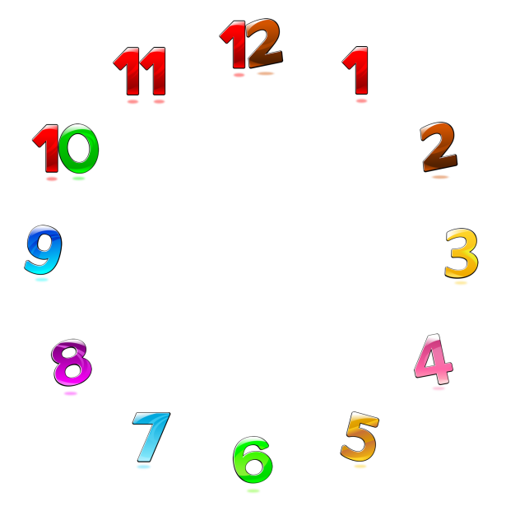
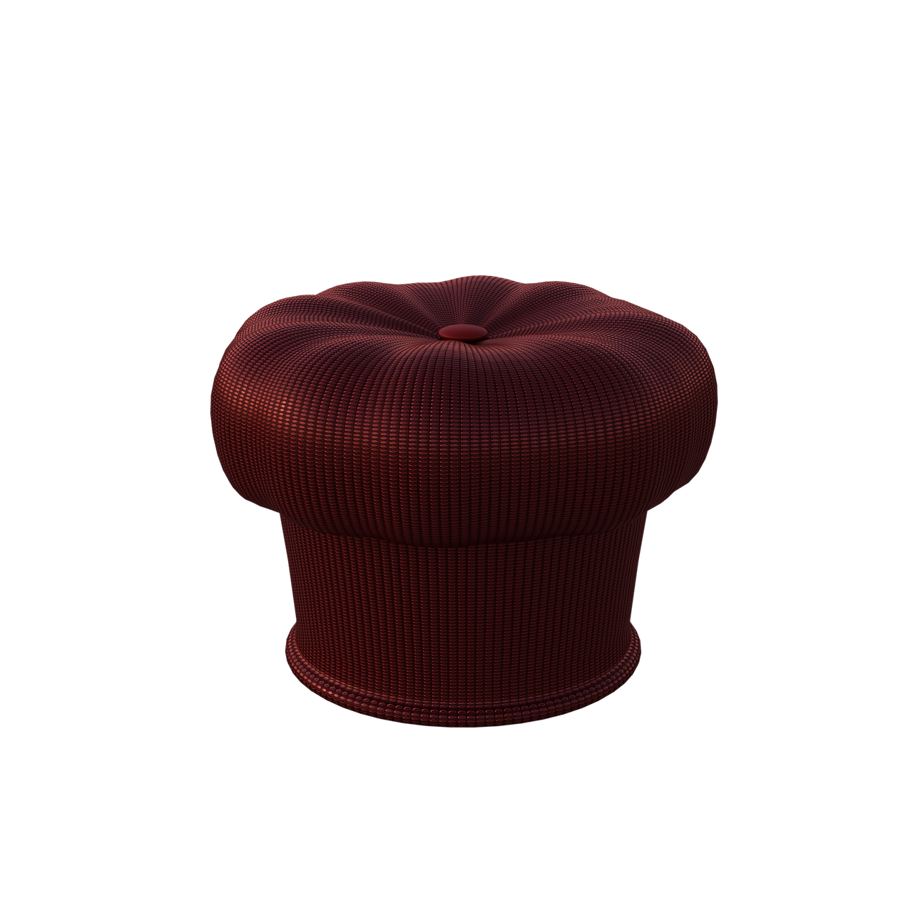
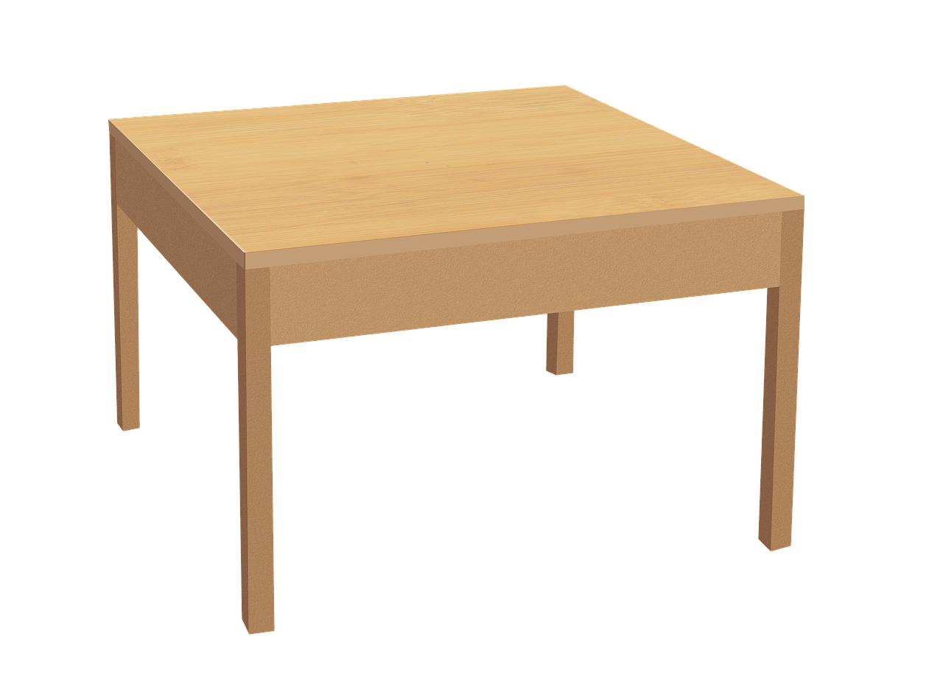
JAMESTOWN KNIGHTS
Hi! I am your 4th Grade Math teacher,
Mrs. Britt!

Slide 2
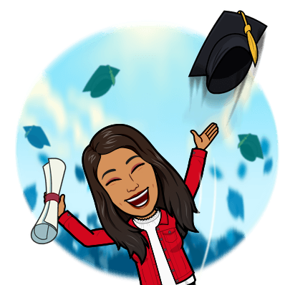
My Credentials
I earned my PK- 8th Grade Teaching degrees from Mount St Mary’s College and Chapman University.
I also hold an Adult Education degree from
Southern Illinois University.
My Experience
I have taught Grades 2,3 & 4 here at Jamestown Elementary. I taught at various schools in Georgia since 2003, to include Windsor Spring, Tobacco Road, and 2 schools in Thomson. In those schools, I have worked in Grades Pre K, K, 1,2, & 3.
Meet The Teacher
Back to Classroom

Slide 3
5 Things to Know
about Mrs. Britt
I live with my husband. We have a daughter and a son, who are all grown up now!
I love reading books. I learn new words, expand my imagination, and gain vicarious experiences that I might not otherwise had.
I like to listen to music, and I like when students show me their latest dance moves.
My favorite thing to do is to travel so I can explore new and exciting places.
Shopping is another one of my favorite things to do! I love coordinating and decorating stuff!
Back to Classroom

Slide 4
EMAIL
britttr@boe.Richmond.k12.ga.us
OFFICE
706 796-4760
Please join my Grade 4
Class DOJO

Slide 5
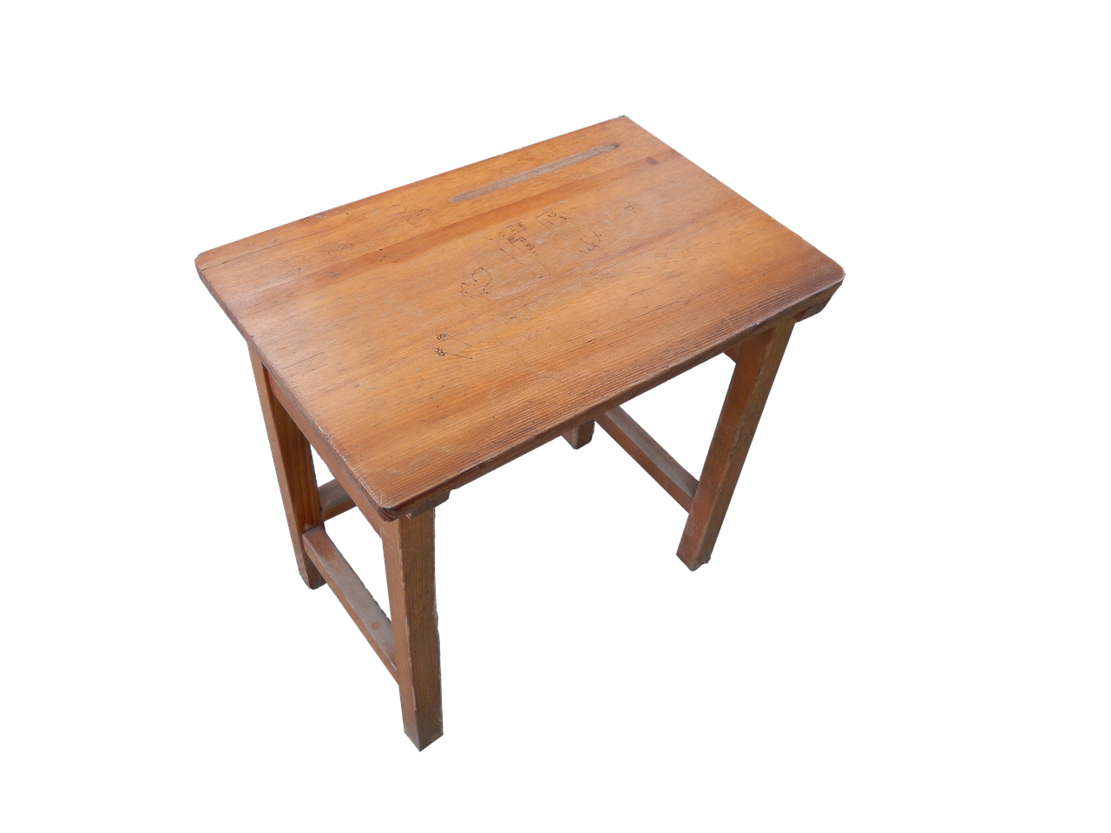
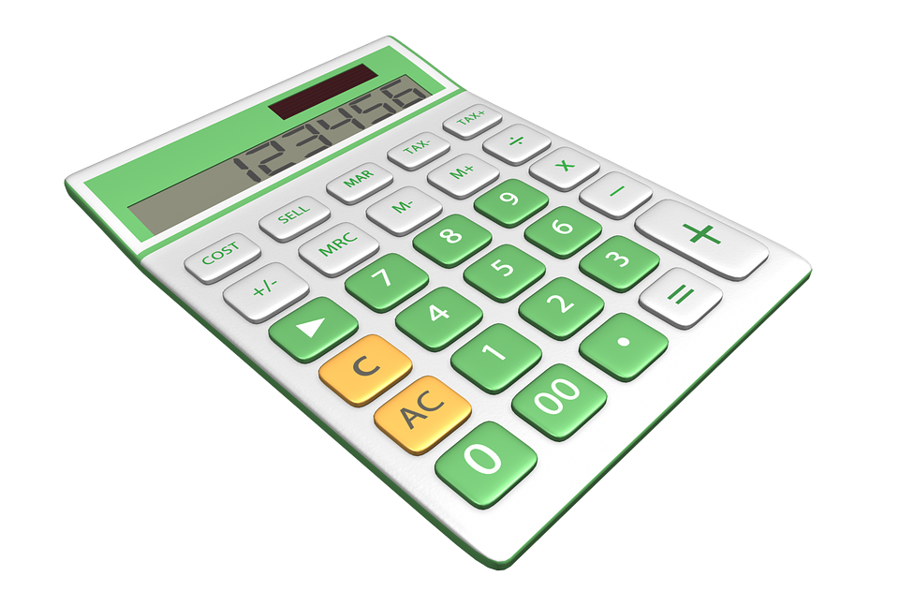
I promise to work hard to facilitate your learning.
I am an advocate of all people going as far as they can in their education.
I believe education to be an equalizer, and I know that people who go to college earn 80% more money than those who don’t.
Use your time
at school wisely!
You are hear to
get the most out
of your education
journey and get
ready for your
next step in life.

Slide 6
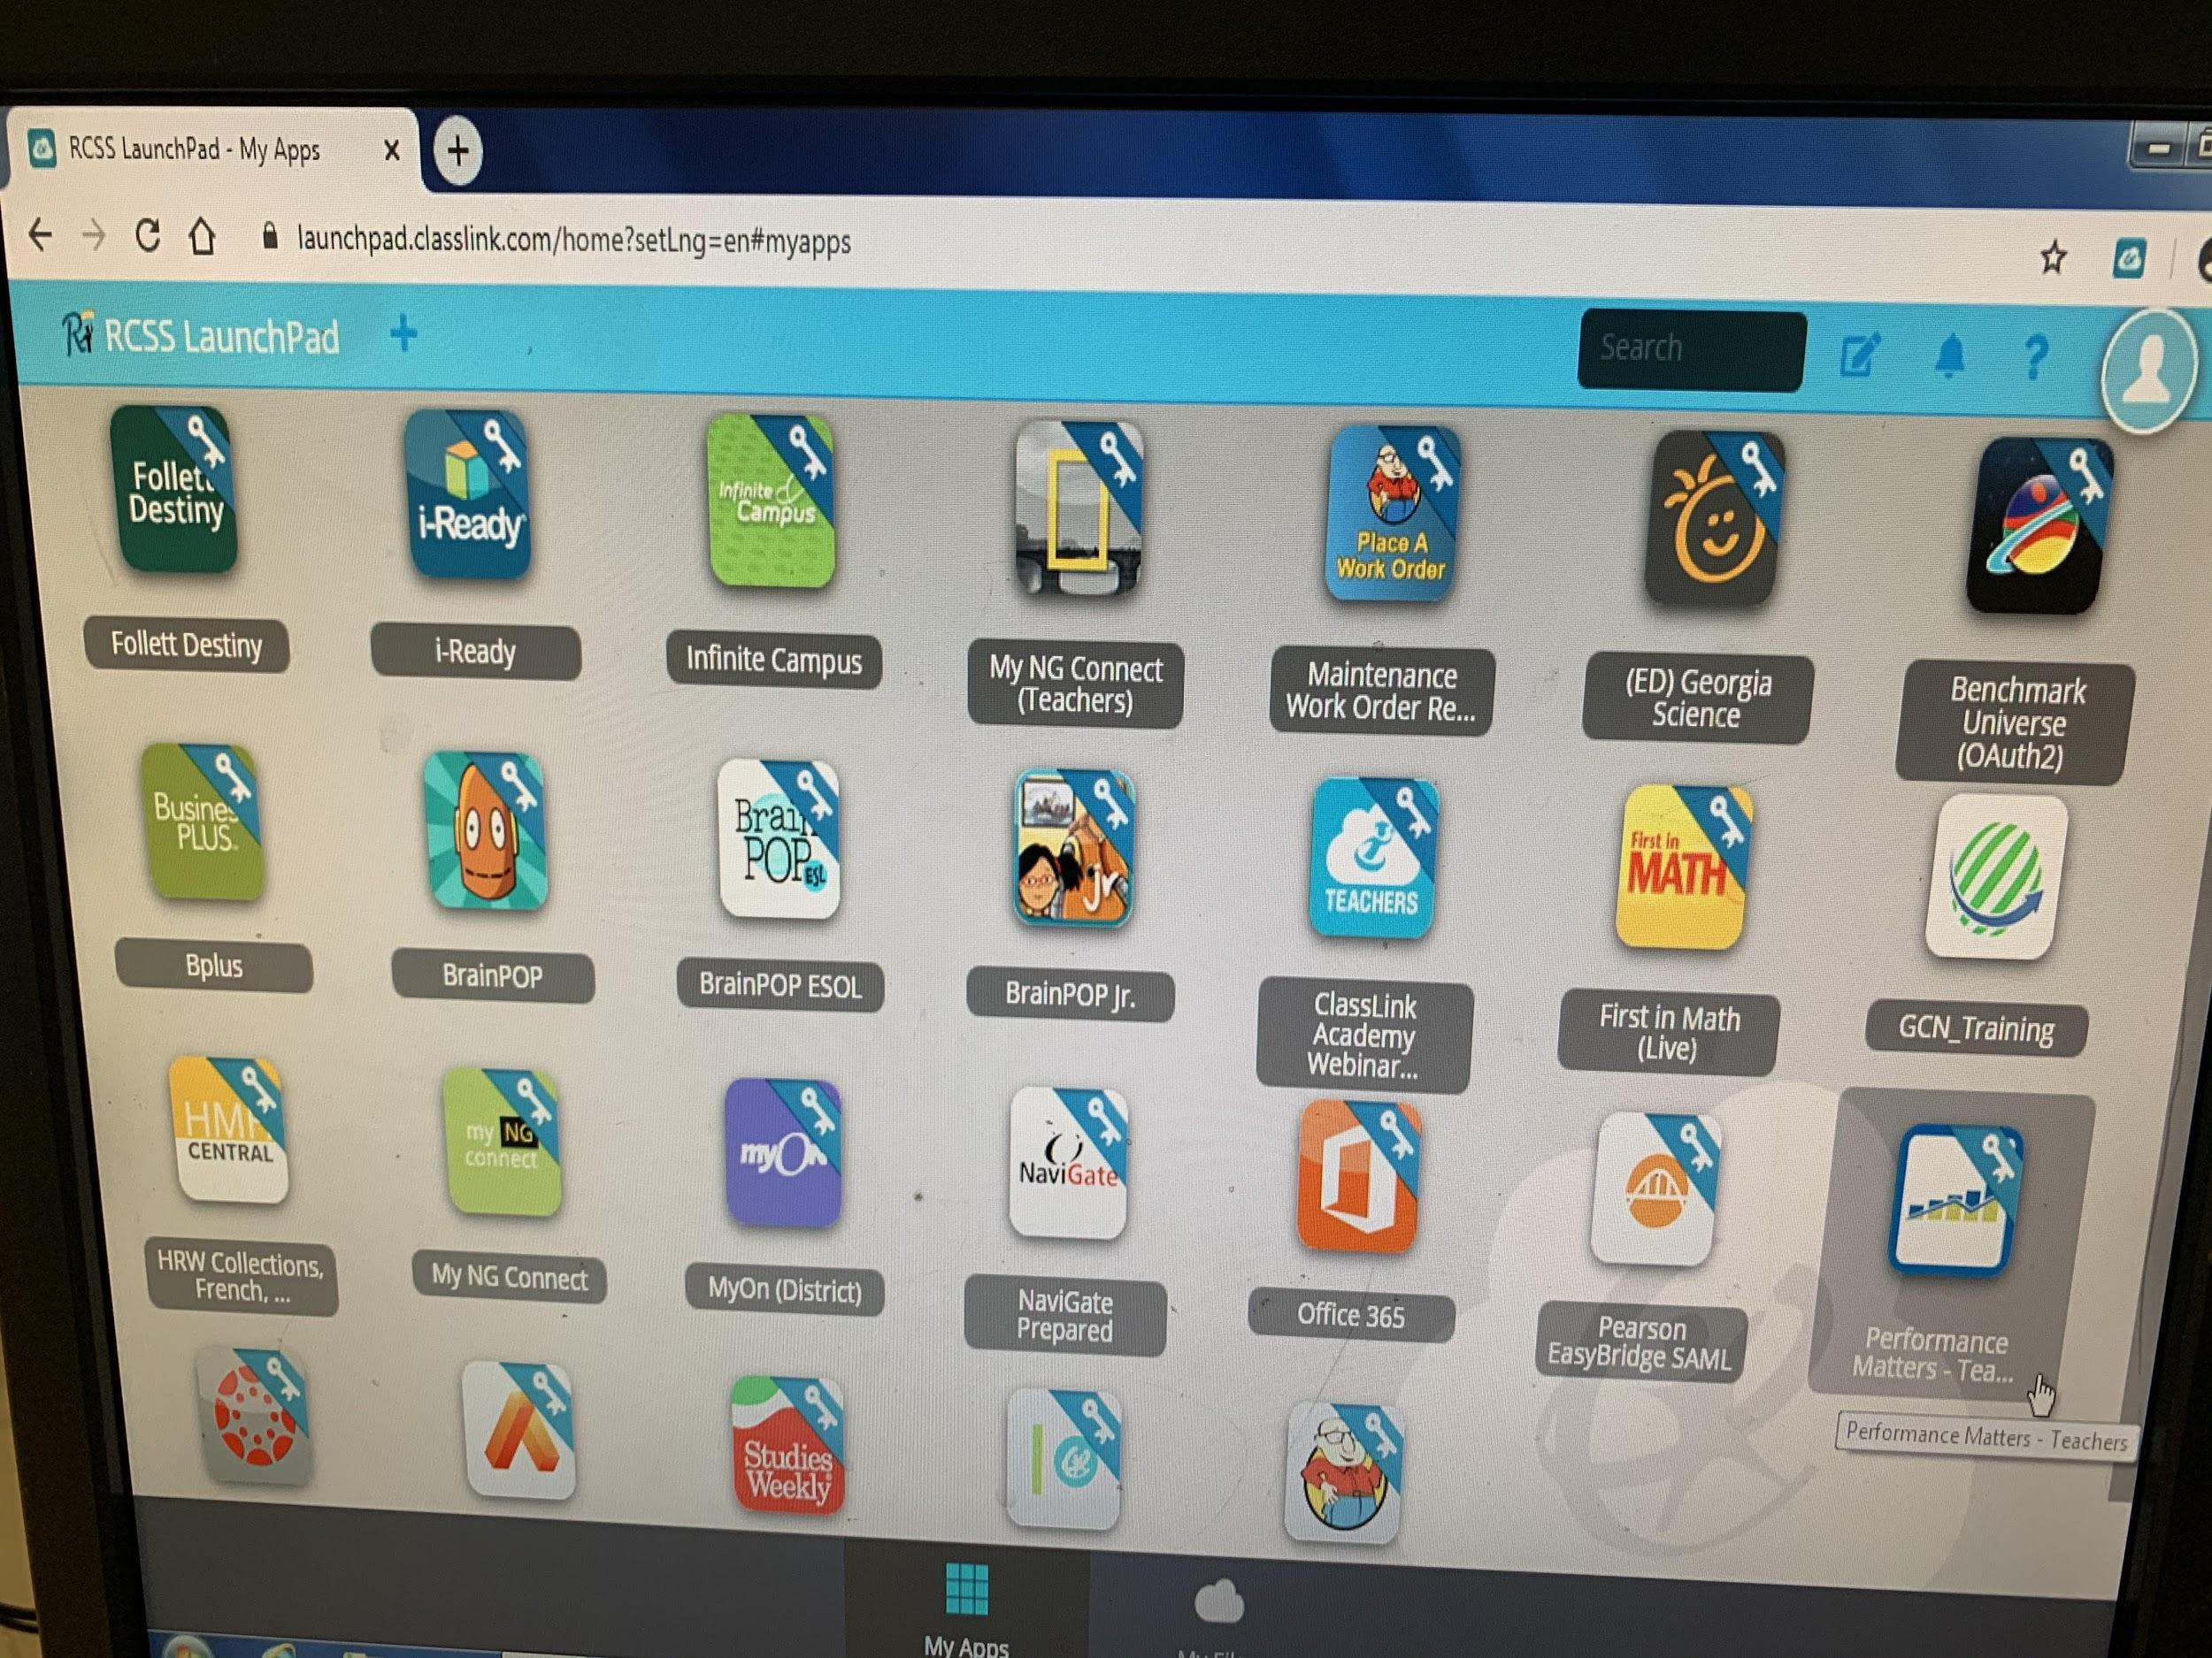
All learning apps will be on the Launchpad, that includes digital textbooks and Canvas! Be sure to take the tutorial before 9-8. Find it at www.rcboe.org

Slide 7
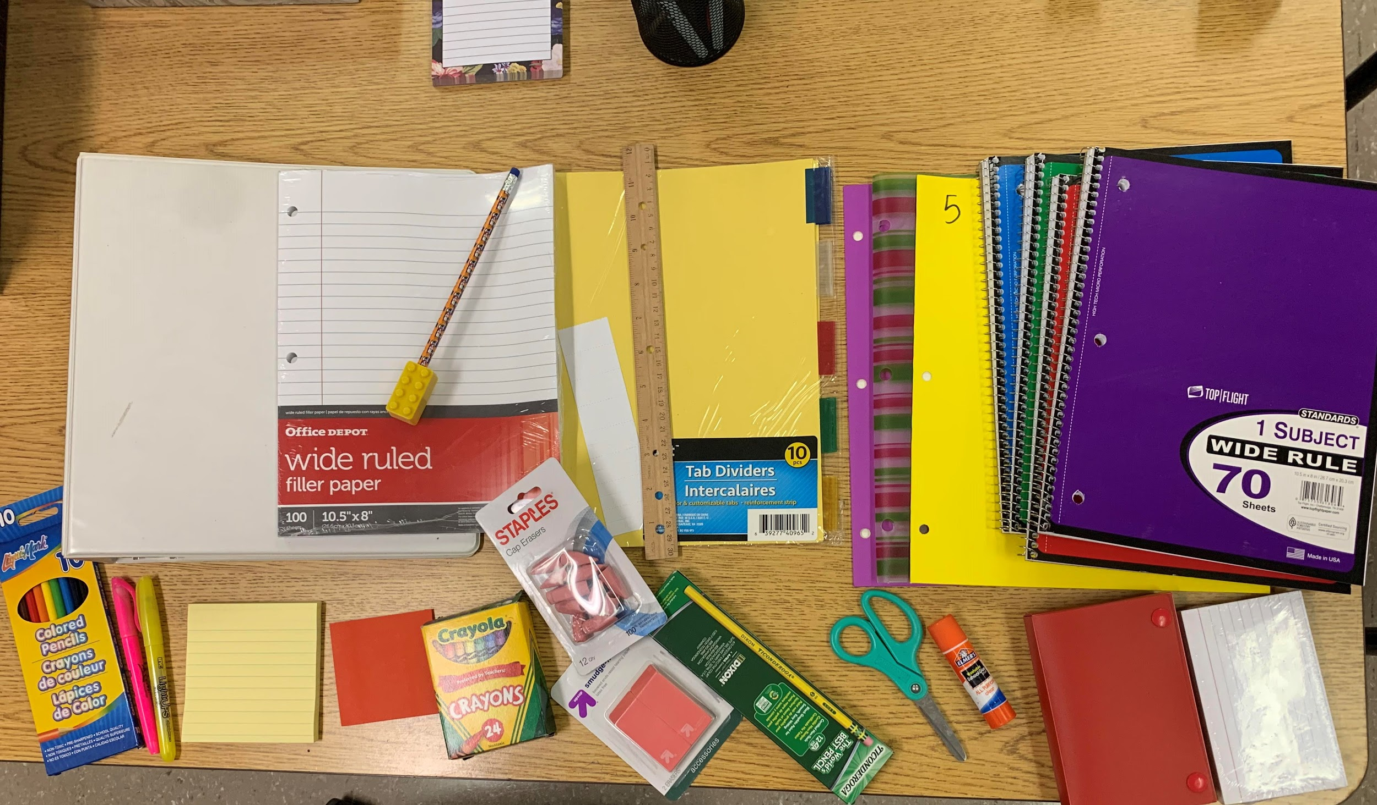
These are some suggested supplies. Your bookbag would be a great place to keep them.

Slide 8
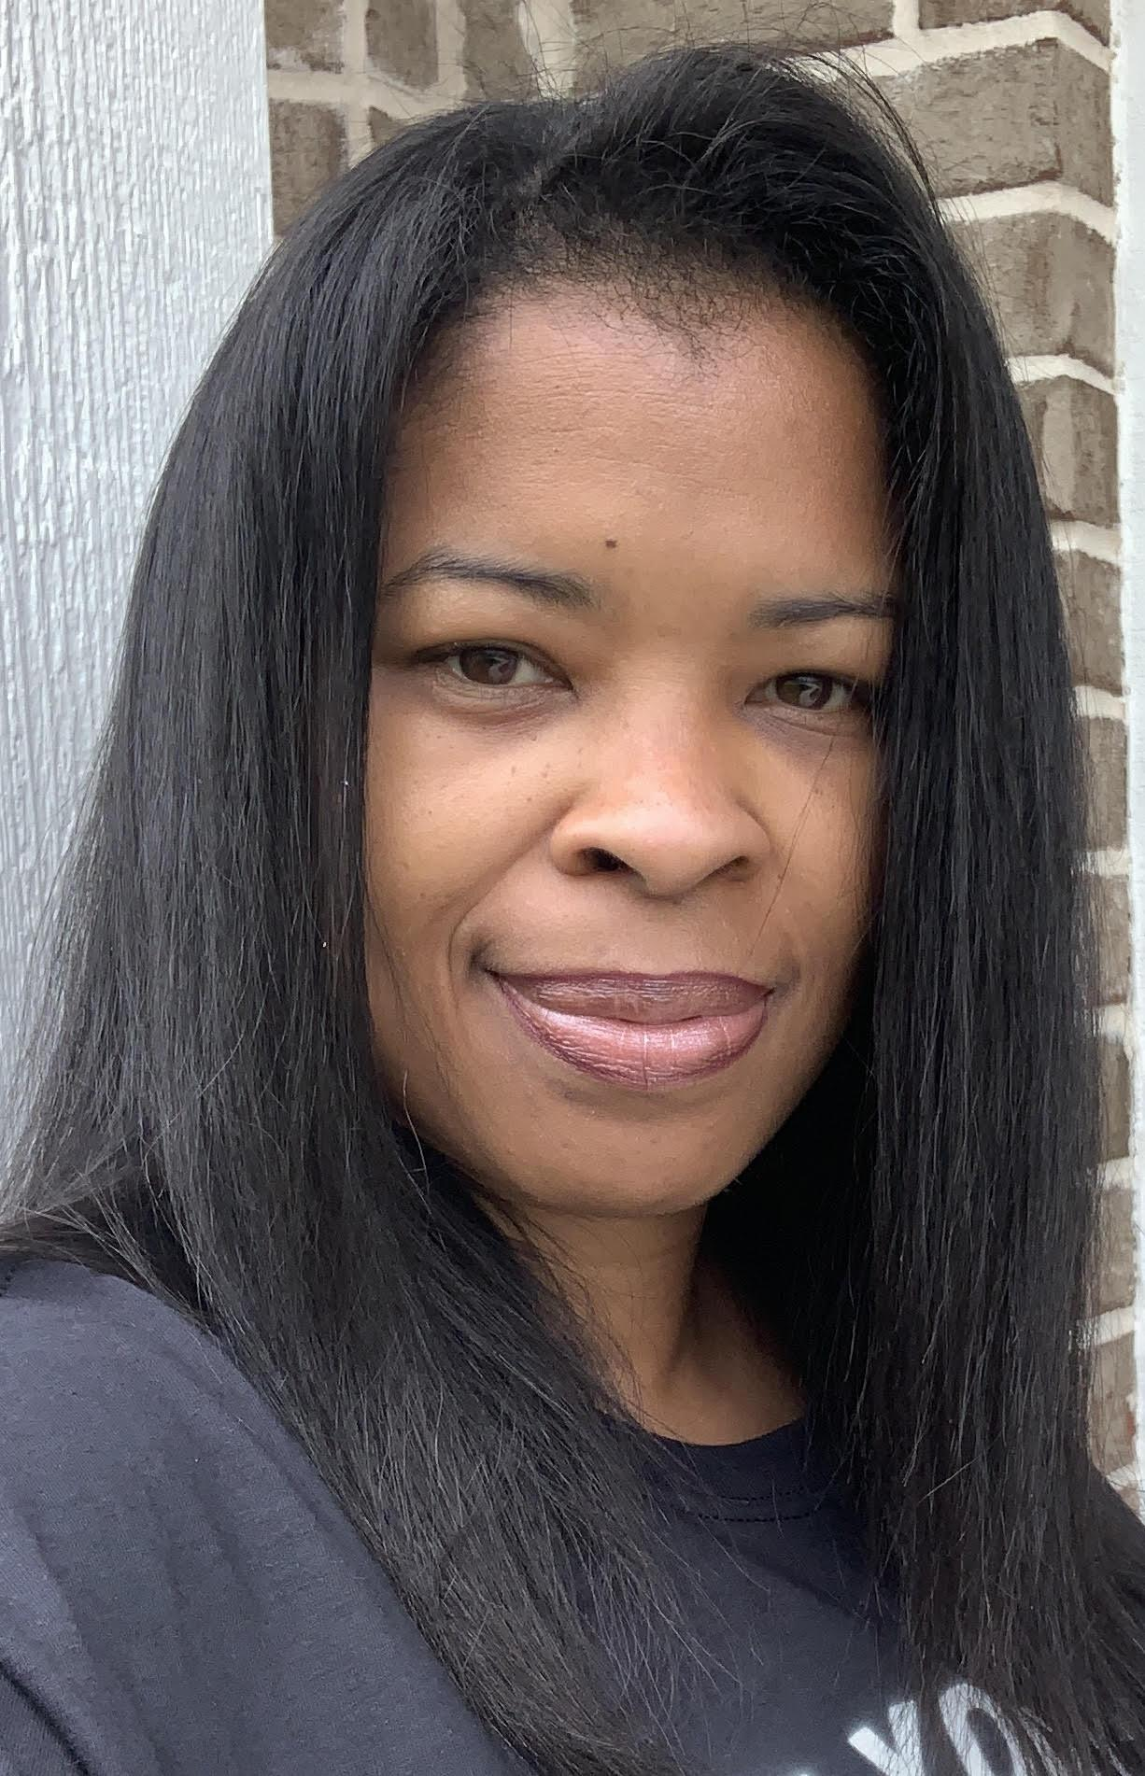
I will see you on the green hall soon!
I’m so excited to meet you!
You can share your headshot,
a picture like, this along with your
5 things I should know about you.
britttr@boe.richmond.k12.ga.us
Class begins Aug. 3!

Slide 9
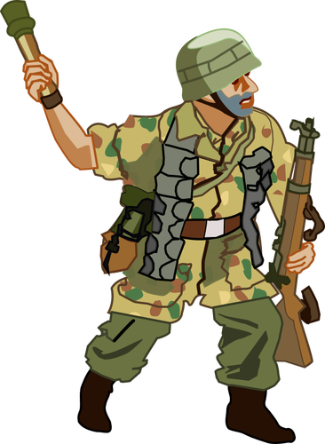
It's Your Turn!
What should I know about you?
You can send me an email at britttr@boe.richmond.k12.ga.us

